Slide 1
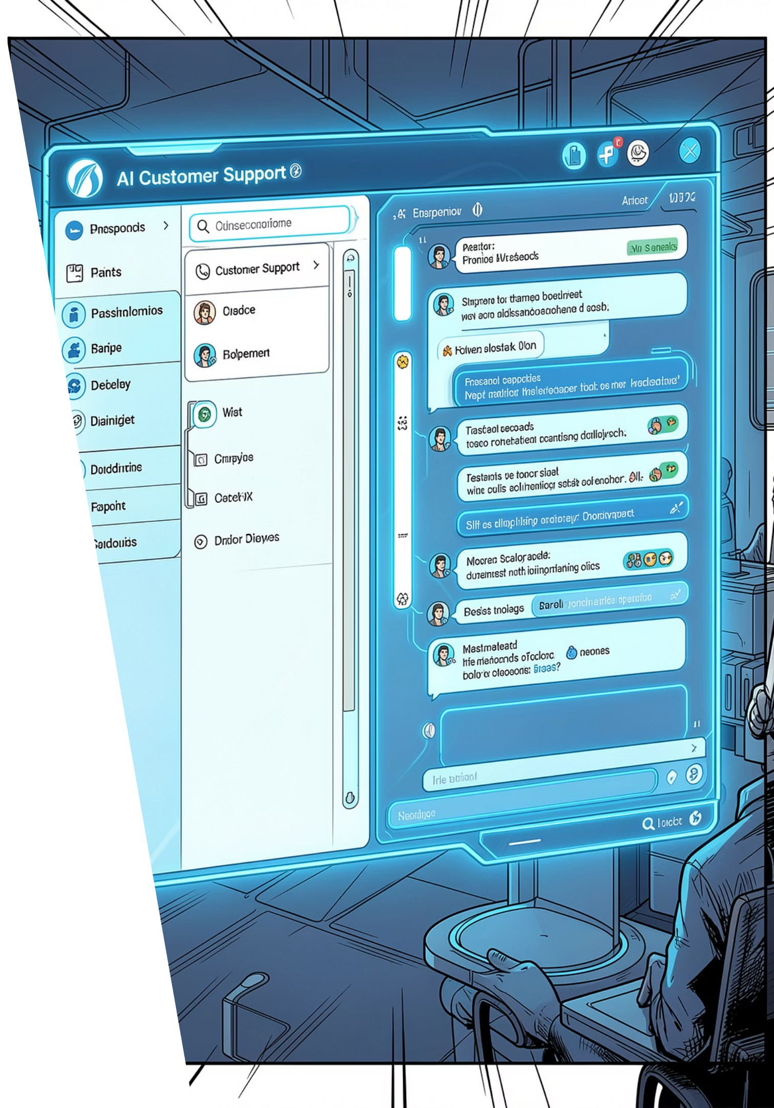
HACKATHON 2025 · DOMAIN 12
Agentic Customer Support Escalation Handler
Domain 12 — Agentic AI & Multi-Agent Systems · CO4 / CO5
Team D15 — Amogh T · Ananya H · Anusha S · Vachanshree P
10 Hours · 4 Members

Slide 2

Problem Statement
E-commerce support teams handle thousands of complex complaints. Build an agentic GenAI system that triages incoming tickets, resolves Tier-1 queries like order status and returns, escalates complex cases to the right Tier-2 team with a contextual brief, and tracks resolution status across a simulated queue.

Slide 3
Domain & Team Profile
Domain Details
Team D15
Domain 12
Agentic AI & Multi-Agent Systems
Outcomes: CO4 / CO5
Duration: 10 Hours
Team: D15
Four members collaborating across agent design, LLM integration, data engineering, and UI development.
Amogh T
Ananya H
Anusha S
Vachanshree P
HACKATHON 2026

Slide 4
Technology Stack
LangChain Agents
LLM API (Grok)
Multi-agent pipeline orchestration with chaining and memory for sequential ticket processing.
Grok API for intelligent ticket classification, auto-resolution drafting, and structured escalation brief generation with advanced reasoning capabilities.
Python
Next.js
Core logic, data processing, and pipeline control across all three agents.
Frontend dashboard UI with real-time ticket status updates, interactive filtering, and responsive design for support team workflows.
pandas
Supabase
Ticket queue management, CSV loading, and data transformation for agent input.
PostgreSQL-backed database with real-time subscriptions for live ticket state synchronization, authentication, and secure API endpoints.

Slide 5
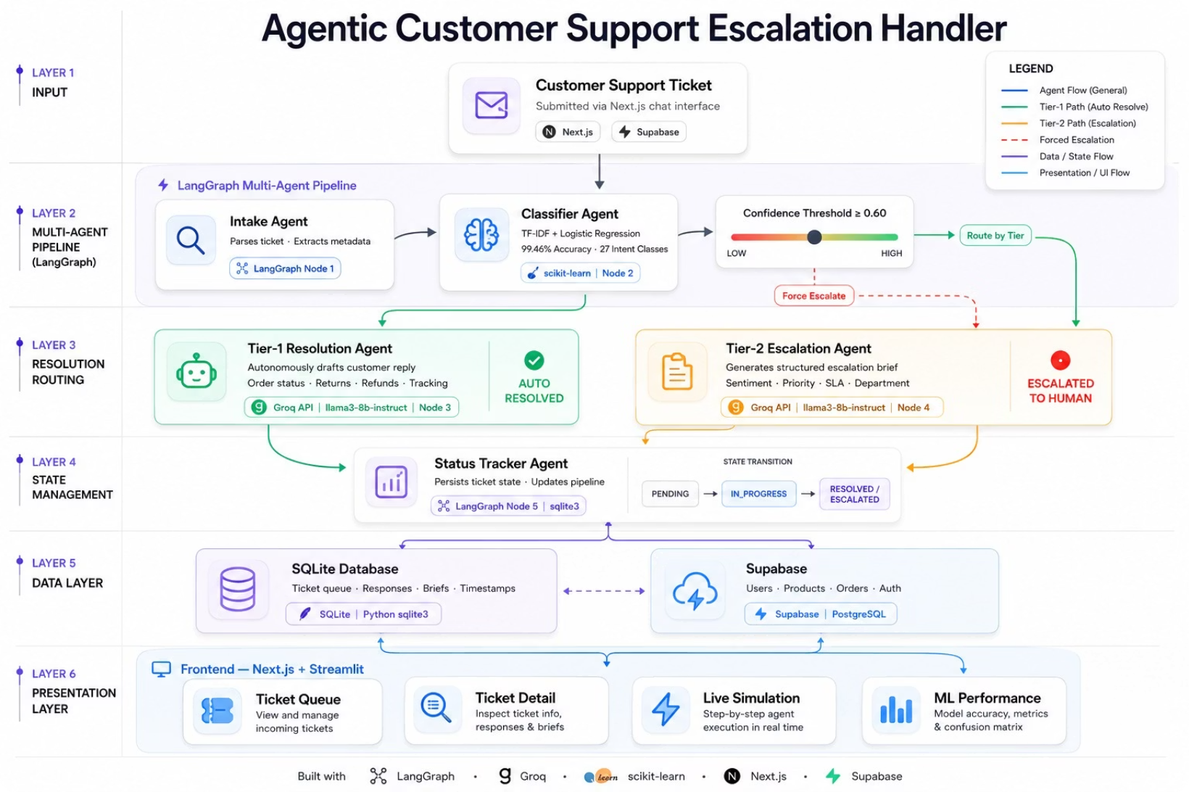
System Architecture

Slide 6
Dataset
Primary: Bitext Customer Support Intent Dataset
Additional Reference Datasets
ORDER · SHIPPING · CANCEL · INVOICE · PAYMENT · REFUND · FEEDBACK · CONTACT · ACCOUNT · DELIVERY · SUBSCRIPTION
The dataset was split 80/20 into 21,497 training samples and
5,375 test samples, using a stratified strategy to ensure all 27
intents were represented in both splits.
The model achieved a weighted F1 score of 0.9957
(99.57% accuracy), exceeding the target of 0.88
by 11.57%.
The 27 intents are divided into Tier 1 (22 intents — simple queries
like tracking orders, refunds, and account management that a bot
auto-resolves) and Tier 2 (5 intents — sensitive cases like complaints,
payment issues, and account deletion that are escalated to a human),
mapped across 7 departments: Logistics, Orders, Returns, Billing,
Account, Support, and General.
27K+
11
27
5
Utterances
Categories
Intents
Columns

Slide 7




Multi-Agent Pipeline
Agent 1: Ticket Classifier
Agent 2: Tier-1 Resolver
Agent 3: Tier-2 Escalator
Input: Raw ticket text
Method: LangChain chain with few-shot prompting
Output: { tier, category, confidence }
Scope: order_status, return_request, basic_faq
Action: Simulated data lookup → auto-resolution
Status: → RESOLVED
Scope: Billing, fraud, technical, legal
Action: Structured brief + department routing
Status: → ESCALATED
All three agents write to Supabase on completion. Real-time subscriptions sync ticket state changes instantly to the Next.js dashboard, ensuring live status tracking across PENDING → RESOLVED / ESCALATED states.

Slide 8
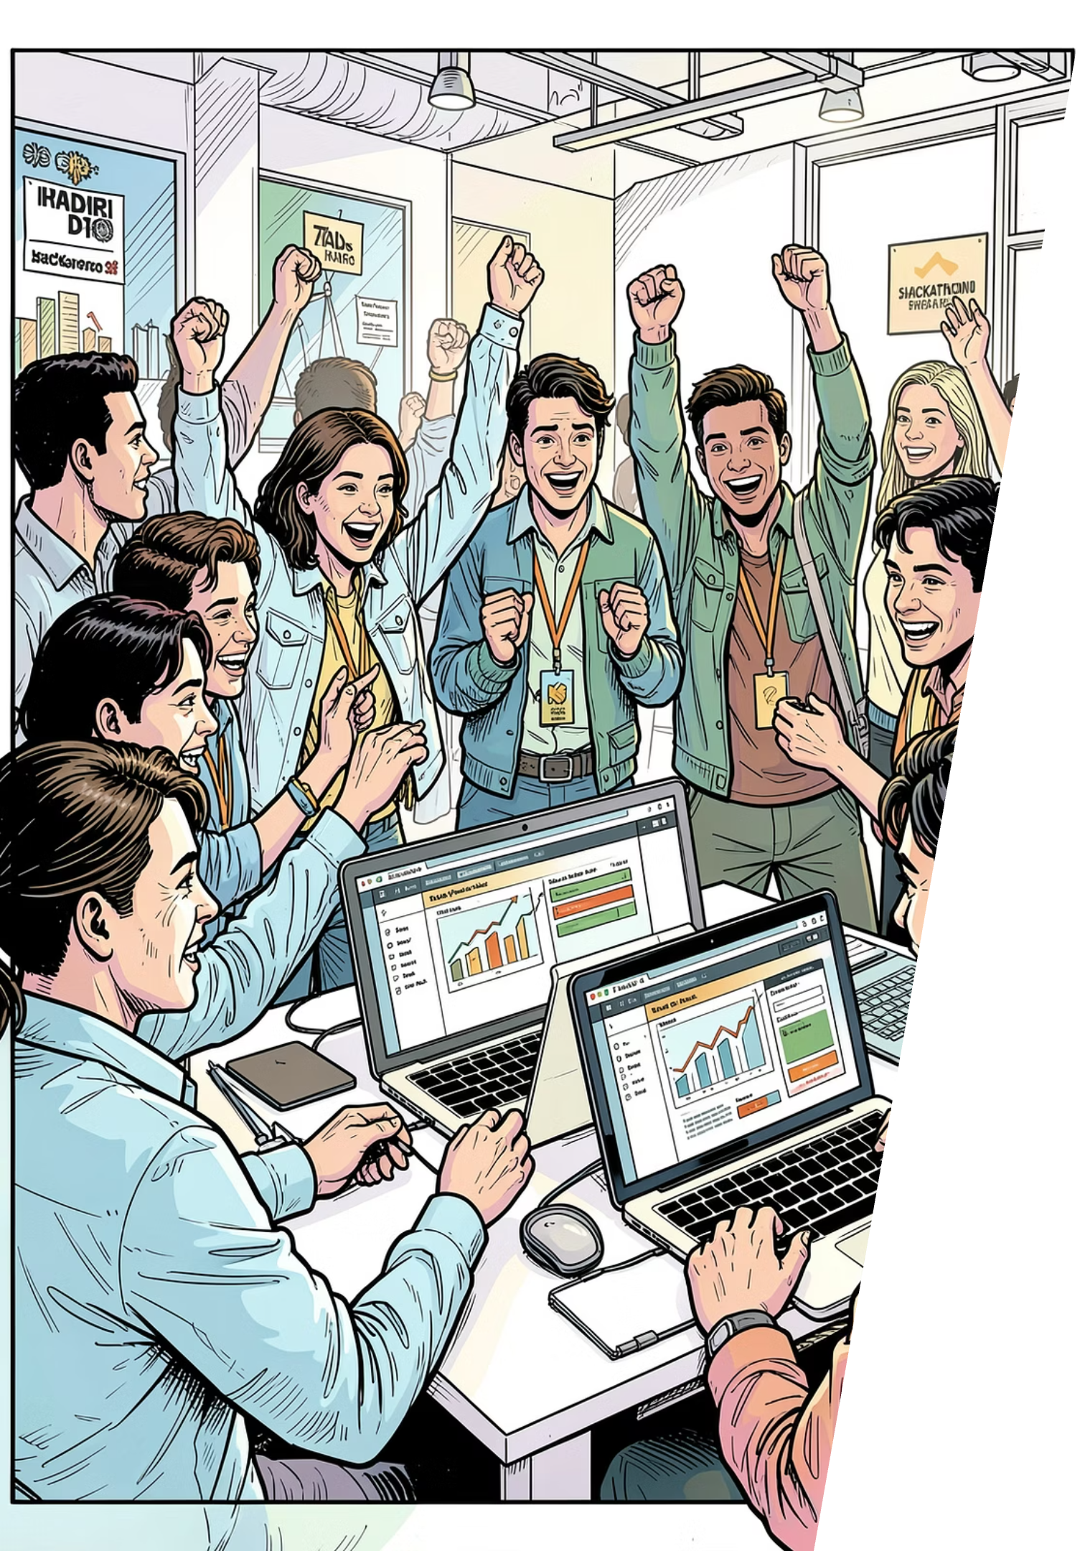
SUMMARY
Agentic Customer Support Escalation Handler
3-Agent Pipeline
Classifier → Resolver / Escalator using LangChain + Grok orchestration
Rich Training Data
27,000+ Bitext utterances across 11 customer support categories
Live Dashboard
Next.js UI with Supabase-backed real-time resolution tracking
End-to-End Flow
Ticket ingestion → classification → resolution → customer response
Thank You
Questions & Discussion
Team D15 — Amogh T · Ananya H · Anusha S · Vachanshree P · Hackathon 2026

